Slide 1
Optimize Network Traffic with Microsoft Graph: Understand Throttling

Slide 2

Overview
Microsoft Graph Overview
Understand Throttling in Microsoft Graph
What Happens when Requests are Throttled?
Identifying Throttled Requests
Explain Common Throttling Scenarios

Slide 3
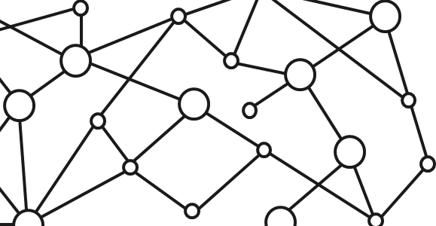
Microsoft 365 Platform
Extend Microsoft 365 experiences
web, device, and service apps
Build your experience
Documents
Pages
Conversations
Timeline
iOS/Android/Windows/Web
1
Microsoft Graph
Notes:
Our Office 365 developer vision focuses on the Users’ experience and their data. As a developer you can bring your applications into their user experience. With over 1.2+ billion users of Office worldwide, this is a huge opportunity to provide a window into your applications. As well as being able to connect into their data and add intelligence to your applications. There are currently 850 million events created a month and a total of 470Pb+ of data stored in the service that can add value to for our Users’.

Slide 4
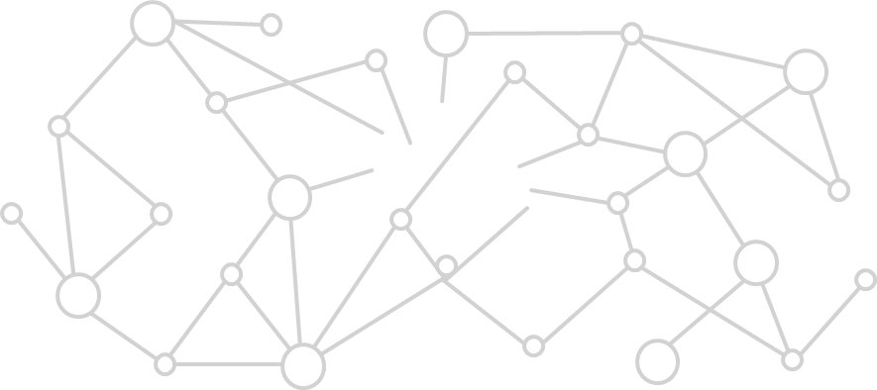
Microsoft Graph Gateway to your data in the Microsoft-cloud
https://graph.microsoft.com
Office 365
Windows 10
Enterprise Mobility + Security
Users, Groups, Organizations
Outlook
SharePoint
OneDrive
Teams
Planner
Excel
OneNote
Activities
Device Relay
Commands
Notifications
Azure AD
Intune
Identity Manager
Advanced Threat Analytics
Advanced Threat Protection
Mail, Calendar,
Contacts and Tasks
Sites and Lists
Drives and Files
Channels, Messages
Tasks and Plans
Spreadsheets
Notes, and more…
Identity Management
Access Control
Synchronization
Domains
Administrative Units
Applications and Devices
Advanced Threat Analytics
Advanced Threat Protection
Alerts
Policies
and more…
Notes:
Microsoft Graph is the gateway to your data in the Microsoft Cloud as you can see from the list of resources, services and entities at the bottom of the slide, there are a lot of things we can take advantage of in the Microsoft 365 platform. We can work with mail, calendar, contacts, tasks in addition to content inside of SharePoint sites and lists, files inside of OneDrive, interact with Microsoft Teams and many more things we can take advantage of.
Each of these services typically has it’s own API that we can leverage to read and write to these different services. However it can be challenging and cumbersome to work with these different services as each has implemented their own endpoint, permission model, syntax for performing some operations like searching and other subtleties. Each endpoint is also secured with Azure AD which means that developers will need to authenticate with Azure AD and obtain an OAuth access token for each service they want to work with.
The Microsoft Graph addresses many of these challenges by acting as a proxy to a lot of these different services. It encompasses data residing in Office 365 such as mail, calendar, contacts and OneDrive as well as many others. In addition, it also provides access to Windows 10 and Enterprise Mobility + Security under a single endpoint. This endpoint, https://graph.microsoft.com, allows developers to create applications that will only have to authenticate once and obtain a single access token that can be used to retrieve data from multiple sources, greatly simplifying the development process.
Each service will sill have their individual permissions, or scopes, but all these permissions are defined in a single place under the Microsoft Graph endpoint, and it handles the underlying calls and permission requests to each of these different endpoints.

Slide 5
Microsoft Graph, gateway to Microsoft 365
Single resource that proxies multiple Microsoft services
Simplifies token acquisition and management
Eliminates the need to traditional discovery (using “me” and “myorganization”)
Allows for easy traversal of objects and relationships
Notes:
As the previous slide stated, the Microsoft Graph is your gateway to all data in Microsoft 365. It is a single resource that proxies multiple Microsoft services.
Because the Microsoft Graph acts as a proxy endpoint to multiple endpoints for each Microsoft 365 service, it will simplify the process of obtaining OAuth access tokens that you must include with each request to one of these endpoints. Unlike the process of obtaining a different token for each endpoint, the Microsoft Graph enables you to obtain a single access token to submit requests that can retrieve data from all the services and endpoints the Microsoft Graph exposes.
One of the other challenges we used to have with these different services was determining the endpoint URL for each service as some were unique per user. To address this, Microsoft created a directory service that you could query to determine what the URL was for the different services. However, the Microsoft Graph greatly simplifies this for you with two special endpoints. The /me and /myorganization endpoints will take you to the root of your user entity or your organization in the Microsoft Graph.
This module will explain how you can easily find relationships between entities in the Microsoft Graph and traverse these objects to find related content. Using the /me and /myorganization endpoint in combination with the ability to traverse related entities, the Microsoft Graph makes it easy to access your data.

Slide 6
Understand Throttling in Microsoft Graph
Microsoft Graph limits the number of concurrent calls to the service
Prevents overuse of Microsoft Graph resources to maintain service health
To maintain service health, Microsoft Graph implements a throttling approach to overuse
When an overwhelming number of requests are received by Microsoft Graph, requests are throttled
Throttling limits differ for each scenario and endpoints
Notes:
Microsoft Graph is designed to handle a high volume of requests. If an overwhelming number of requests occurs, throttling helps maintain optimal performance and reliability of the Microsoft Graph service. Throttling limits the number of concurrent calls to a service to prevent overuse of resources.
Throttling limits vary based on the scenario. For example, if you are performing a large volume of writes, the possibility for throttling is higher than if you are only performing reads.
Developers may ask “what are the throttling limits per hour or per day”, but this is not an easy question to answer. Microsoft Graph is a proxy service that provides access to multiple Microsoft hosted services and endpoints. Each of these services has their own process for calculating when requests should be throttled. In addition to different services, not all requests are treated equally. A read request is not as demanding on the services as a write operation. Furthermore, not all read or write operations can be treated equally. A read request for the ID and name of 50 groups is very different from including the $expand query operator to include the ID, name, email and phone number for all members in those groups.

Slide 7
What Happens when Requests are Throttled?
Allowed limits vary for different scenarios (for example, read vs. write) & different endpoints
When request limits are exceeded, additional requests are limited from that client for specified period
Any future requests before the time period specified will continue to be throttled
Not all requests are throttled when limits are exceeded
In some scenarios, high volume of writes can trigger throttling, but reads can still be requested
Notes:
What does Microsoft Graph do when it determines that requests by a specific client should be throttled? First, consider what it means when a request is throttled.
When the client issues a request that is throttled by Microsoft Graph, this is the service’s way of telling the client “your requests have been determined to be negatively impacting the service which can impact the health, responsiveness and reliability of the service for others.”
In the situation where requests are throttled, Microsoft Graph is telling the client “do not issue any more requests until a specific time”. This timeframe is commonly just a few seconds, but some services may require a longer delay.
Any requests before this delay time has elapsed will continue to be throttled by Microsoft Graph. In some cases, it can also cause the delay to be extended.
In some scenarios, while some requests are throttled, other requests by the same client to the same endpoint may be allowed. For instance, a high volume of write requests could trigger Microsoft Graph to throttle future write requests, but read requests would still be allowed.

Slide 8
Identifying Throttled Requests
Successful requests to Microsoft Graph result in responses of HTTP successful status codes (200-299)
200: OK
201: created (for example, create operations)
204: no content (for example, delete operations)
Failed requests result in responses of HTTP client error status codes (400-499)
400: bad request
401: unauthorized
403: forbidden
404: not found
429: too many requests
Microsoft Graph always returns HTTP status code 429 in the response when requests are throttled
Notes:
The first step to understanding throttling is being able to identify when a request is throttled by the Microsoft Graph.
In HTTP APIs, the result of a request is indicated by the HTTP status code returned. HTTP status codes are classified in groups.
For example, successful status codes are in the range of 200-299. Common successful status codes include 200 (used when requesting a resource) or 201 and 204 (used on write operations for creating, updating or deleting resources).
Error status codes are in the ranges of 400-499 & 500’s. Common failed status codes include 400 (bad request), 401 and 403’s (usually a permission or auth issue), and 404 (used for a not found request).
The status code returned for throttled requests is 429, which stands for “too many requests”. All requests that are throttled by Microsoft Graph will return 429 when they are throttled.

Slide 9
Identifying Throttled Requests
Microsoft Graph exposes multiple endpoints from different Microsoft services
AzureAD (users & groups)
Exchange (calendar, contacts & messages)
OneDrive
OneNote
SharePoint
Microsoft Teams
etc
Some (but not all) endpoints return an additional Retry-After header when requests are throttled
Specifies number of seconds to wait before submitting another request
Notes:
Keep in mind, Microsoft Graph is a proxy service to multiple Microsoft services, such as AzureAD for users and groups, Exchange for calendar, contacts and messages, OneDrive, OneNote, SharePoint, Microsoft Teams and many more services.
Each of these services have their own rules and calculations for when limits are exceeded and future requests will be throttled.
Many, but not all, of these endpoints will also return an additional value in the response’s HTTP headers that the requester can use to determine how long they should wait before submitting another request.
This header value, Retry-After, is typically an integer that represents the number of seconds the client should wait before submitting the request again. Any requests sent prior to this time will continue to be throttled and may cause the Retry-After value to increase as well.
However, not all services include the Retry-After value so your applications should have a default number to rely on when this HTTP header is not included.
It is important to keep in mind that some services have hard-coded Retry-After values while other services have dynamic numbers that are calculated based on the type of request and the current conditions. Therefore, you should not treat one Retry-After as a universal or uniform number across all services and for all future requests.

Slide 10
Explain Common Throttling Scenarios
Determining specific throttling limits is not an exact science
Many factors used to calculate how expensive a request is on the underlying service resources
Endpoint
Type of request (for example, read / write)
Complexity of the request
Common throttling scenarios:
Large number of requests across multiple endpoints in a tenant
Large number of requests from a specific application across all tenants
Large number of requests for large data responses ($expand, not using $select, $top, $skip, etc.)
Large number of complex requests ($expand, $filter)
Notes:
Now that we have covered what throttling is, why requests can be throttled, and what it means to be throttled, let’s look at some common scenarios that can cause requests to be throttled.
This is not an exact science; you will not find reliable metrics that can be applied or assumed across all applications, endpoints and request types. Rather, consider what goes into determining when requests should be throttled.
As a general rule, you can think of it like this: how expensive request is on a particular endpoint is the determining factor.
What is used to determine how expensive a request is? That’s the part that depends on different situations: which endpoint is the request targeting, is the request a read operation or is it writing (creating, updating or deleting) data, and finally, how complex is the request.
Here are a few examples of scenarios that can experience throttled requests:
Large number of requests across multiple endpoints in a tenant or a large number of requests from a specific application across all tenants.
Large number of requests for large data responses. Consider a request that uses the $expand query operator. This tells Microsoft Graph to get additional data and include it in the request. If the request is not using data limiting query parameters such as $select, $top, or $skip for instance, the service must work harder to retrieve and include larger data sets in the response. This would be a much more expensive request than asking for the names, emails and ID’s of users.
Large number of complex requests. Similar to the previous example, consider a request that is forcing Microsoft Graph to not only retrieve additional data (such as the case when the $expand query operator is used), but also to perform conditional checks on the data, such as using the $filter query parameter to limit the data results.
As previously stated, consider how expensive a request is: the more expensive it is and the more of these requests you send, the more likely it is these requests will eventually be throttled.

Slide 11
Demo

Slide 12
Thank you.

